Slide 1
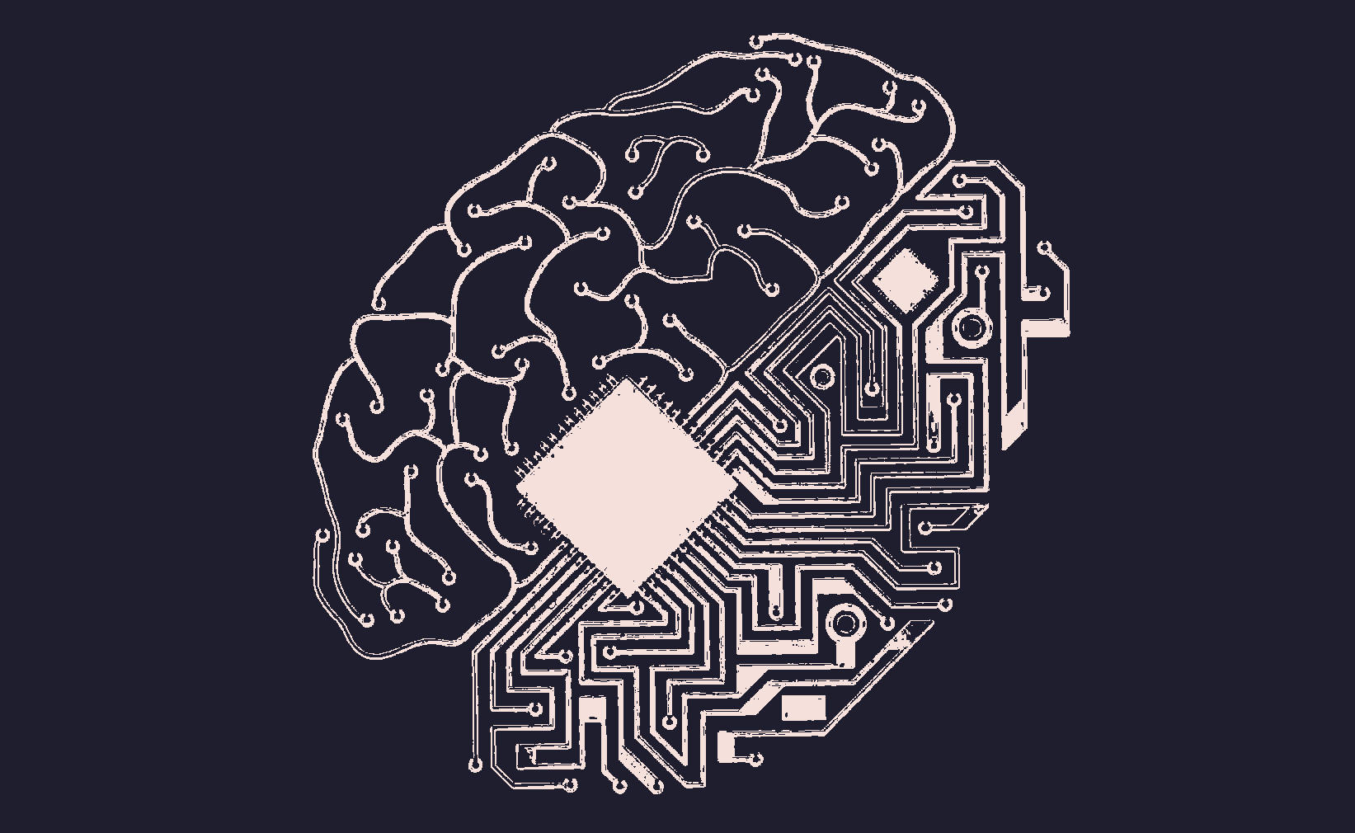
从信息检索的角度浅谈人类记忆与计算机存储系统的异同
Information Retrieval
Human Memory
Computer Storage
李烁安
2022.11.30

Slide 2
背景
两者的共同问题
比较两者的目的
Background

Slide 3
两者共同的问题 Issue
如何快速而精确地提取信息?
How to retrieve the correct information efficiently?

Slide 4
比较两者的目的 Purpose
研究记忆检索机制 ⇄ 改善信息检索技术

Slide 5
类似
类似的阶段
类似的表征方法
依赖线索激活
Similarities

Slide 6
类似的阶段 Stages
Generate & Assemble Cues
Retrieve Using the Cues
Verify the Retrieved Information

Slide 7
类似的表征方法 Representation
Network
Information items are represented as discrete nodes. The retrieval process is based on the connection of the nodes.
Feature
Information items are represented as sets of features.

Slide 8
依赖线索激活 Cue
Cue-based retrieval:
Initial cue must be provided to start off the retrieval, which narrows the process down to a small set of possible pieces of information without a large load on the human system.

Slide 9
区别
建立关联的能力
利用情境的能力
消退的能力
Differences

Slide 10
建立关联的能力 Association
Human Memory
Feature-based
Semantic and abstract relationships
Computer
Meaning-based
Surface features such as word overlap

Slide 11
利用情境的能力 Context
Human Memory
Context is used in both encoding and retrieval of information. Provides various cues and associations that allows many retrieval paths to the information.
Computer
Very little context is encoded. Much more impoverished classification of information.

Slide 12
消退的能力 Decay
Human Memory
Information decays quickly. Otherwise, old information could be too frequently triggered, which distracts the formation of new memories.
Computer
Information remain stored. Weighting based on the history of usage of information is used to prevent interference.

Slide 13
引用文献 References
Foltz, P.W. (1991). Models of Human Memory and Computer Information Retrieval: Similar Approaches to Similar Problems.
Raaijmakers, J. G., & Shiffrin, R. M. (1981). Search of associative memory.
Huggett, M. (2007). Biomimetic information retrieval with spreading-activation networks.
Hiemstra, D. (2009). Information Retrieval Models. Information Retrieval.
Gilbert, L. T., Delaney, P. F., & Racsmány, M. (2022). People sometimes remember to forget: Strategic retrieval from the list before last enables directed forgetting of the most recent information.

